Slide 1

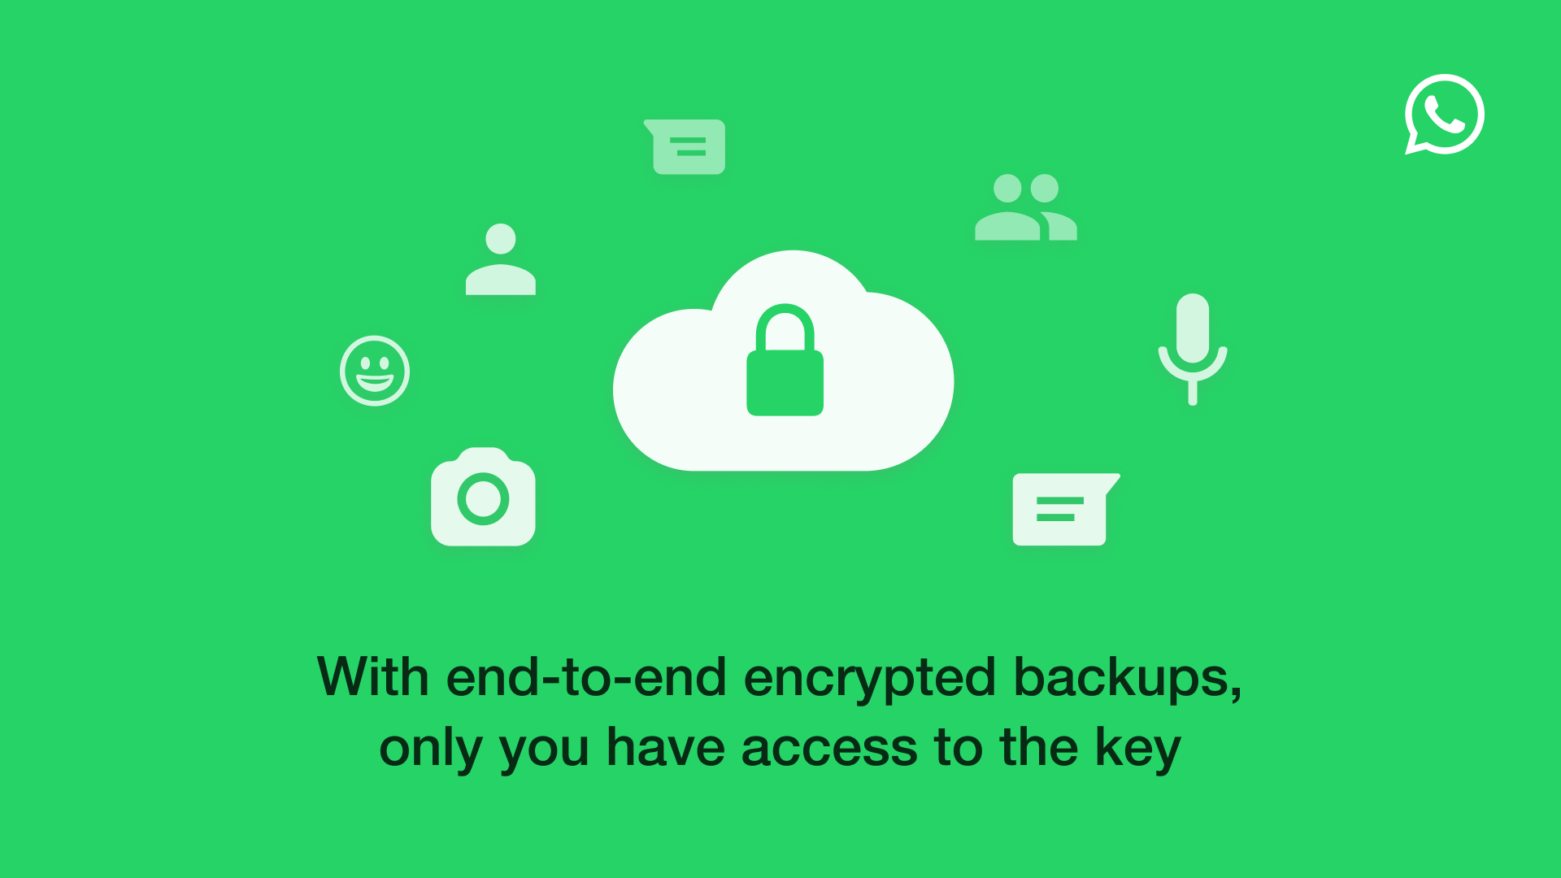


Secret Agent CHat
ENCRYPTION-DECRYPTION SYSTEM
By:
Aravilli Atchuta Ram PES2UG21CS086
Kolisetty Venkata Aditya PES2UG21CS232
Mayank Kashyap PES2UG21CS285

Slide 2

Objective
The project is based on data protection used in various social media apps.
It allows the user to write a plaintext message , encrypt it , save the encrypted message and decrypt it.
It aided us in understanding the background and importance of data security in the today’s digital age and helped us better comprehend implementation of GUI.
Agent08 will help us understand the workings

Slide 3

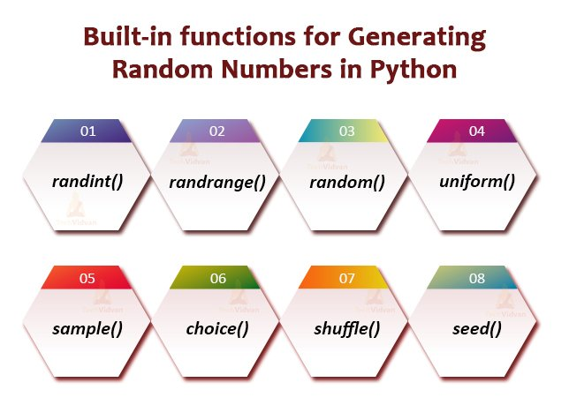
Modules Used
Tkinter
Message box
Scrolled text
File dialog
Buttons & Labels,
Random module
randint

Slide 4
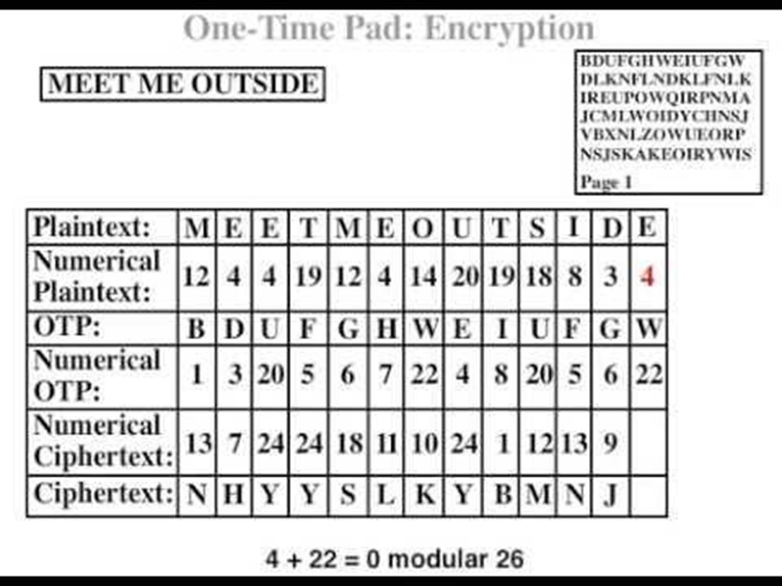
Working of One-Time Pad Algorithm
Symmetric key is used
Private key is shared between the sender and receiver.
Oh! So that’s how it works

Slide 5
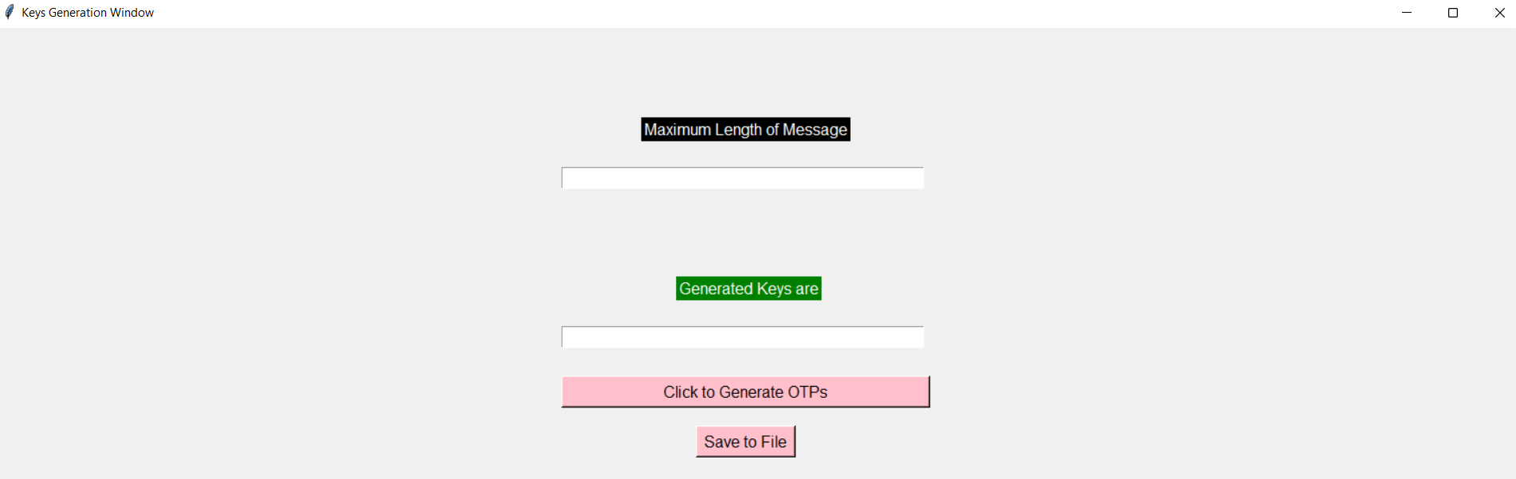
Keys Generation Window
Agent specifies maximum length of message.
Software generates the corresponding keys.
Agent saves the keys to a file.

Slide 6
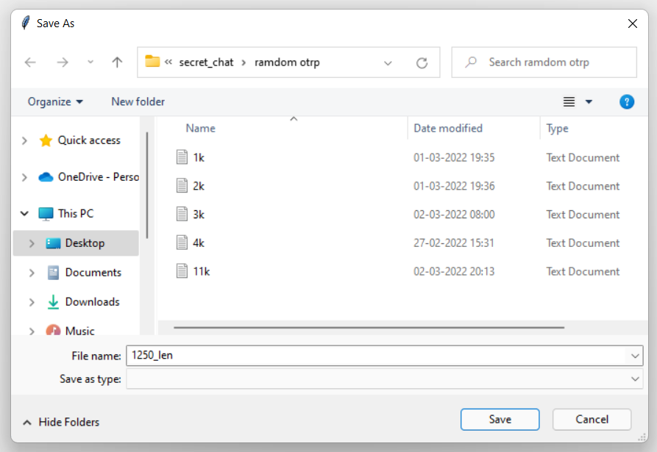
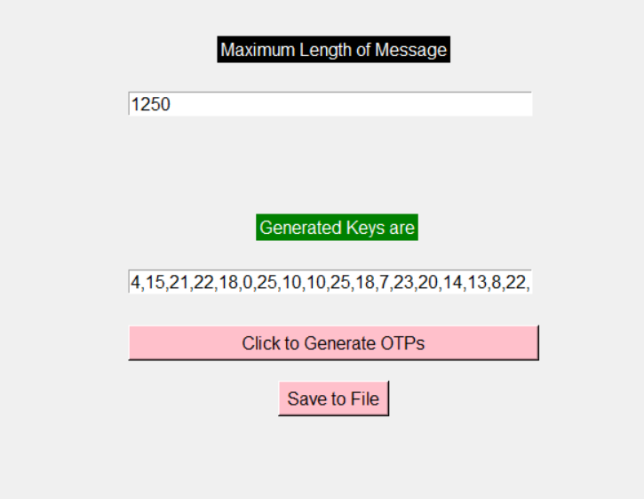
Maximum length of message was given as 1250, and the generated keys are displayed, the file is saved as 1250_length.txt

Slide 7
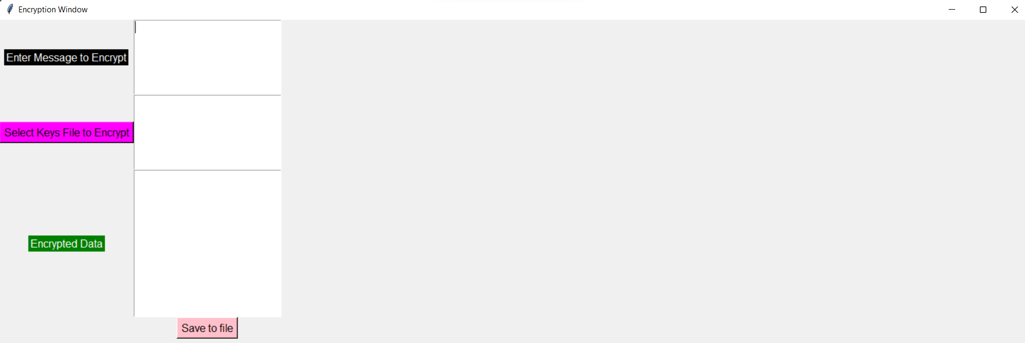
Desired text to be encrypted is entered.
Encrypted data is produced in the text box.
Encrypted text can be saved in a file.
File can be transferred in various ways.
Secret agents can then easily exchange information.

Slide 8
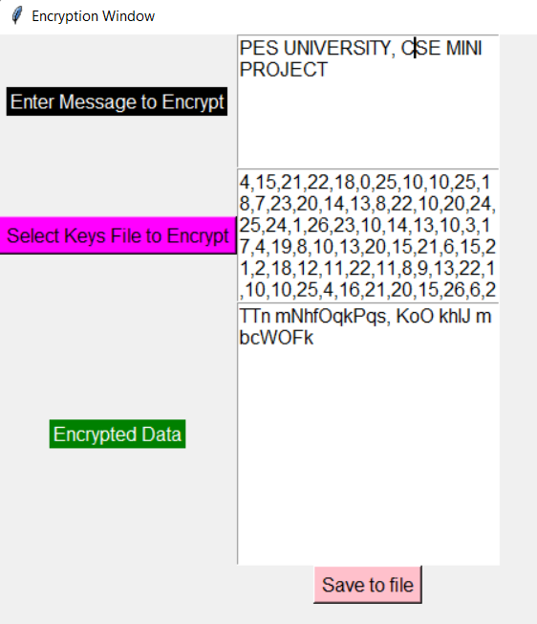
Agent enters a message to be encrypted.
He selects the maximum length to be 1250.
Software encrypts the data and the output is shown in the text box.
The text can be saved in the file.
All that is left now is to safely transfer my file to the gov ..……

Slide 9
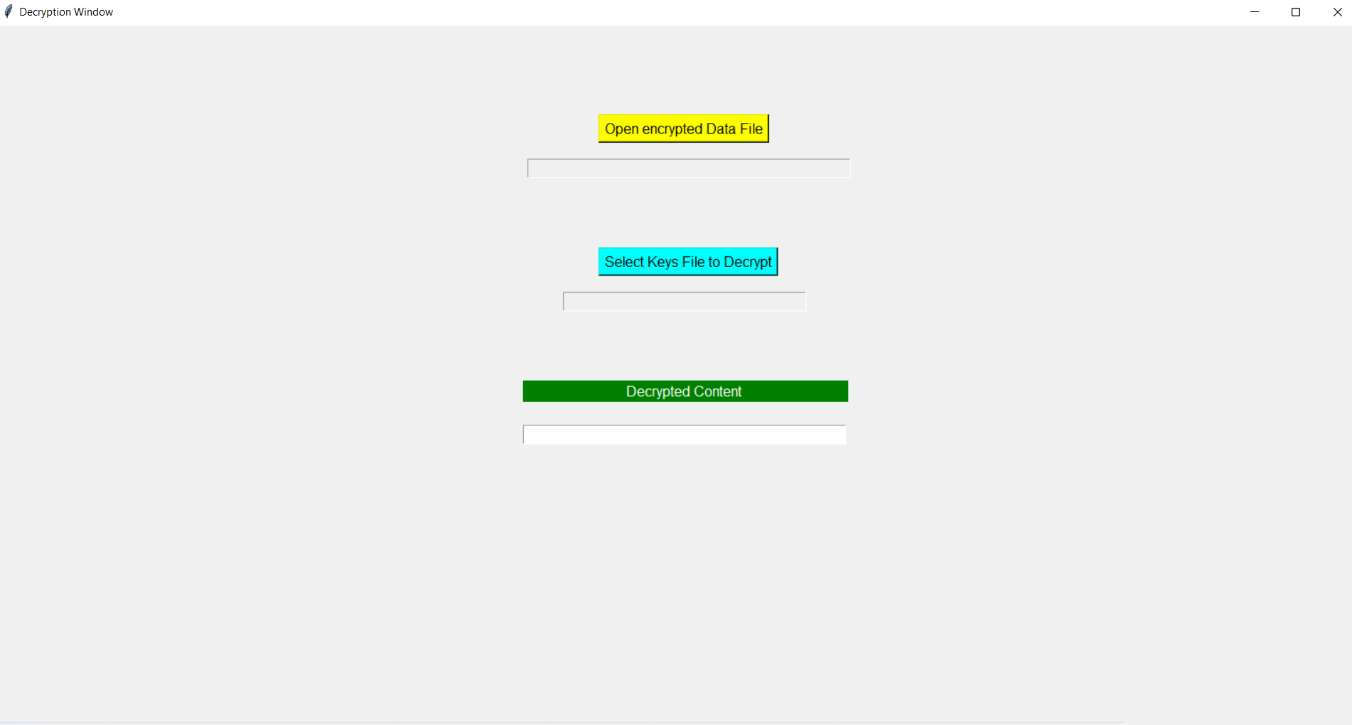
Agent soon receives a message which seems to be encrypted… He opens the decryption software. [Note : Same keys file used for encryption must be used] He saves the message in a file and decrpyts it. The Decrypted content is now visible to him.
Hmm, I see. on to work!

Slide 10
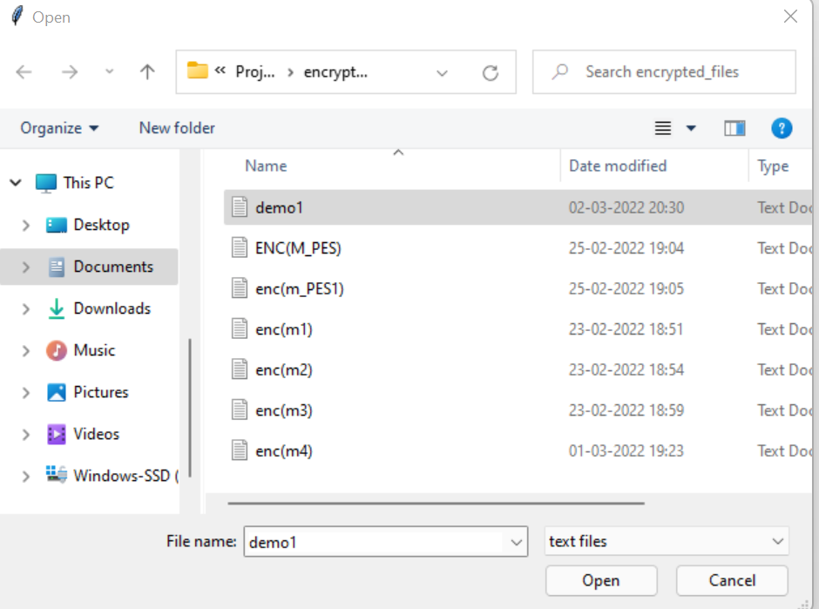
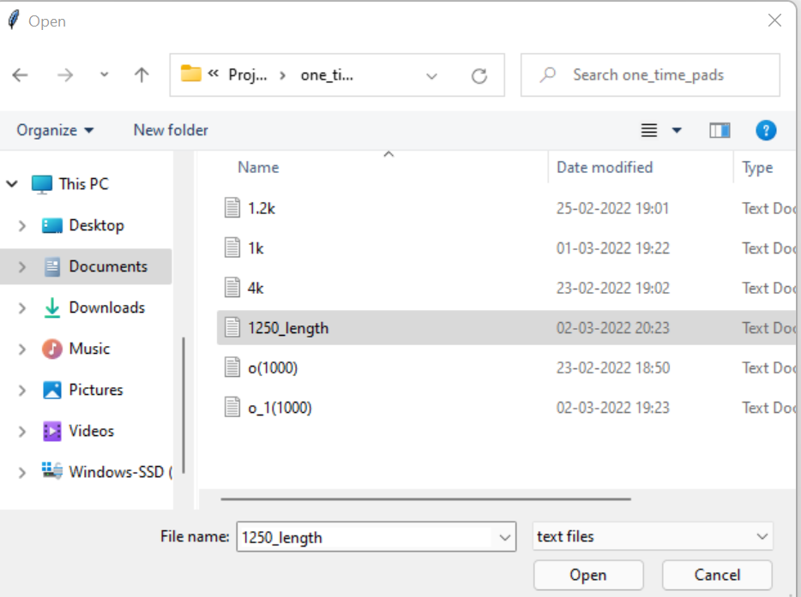
Select demo1.txt from the files listed for the encrypted file
Select 1250_length.txt

Slide 11
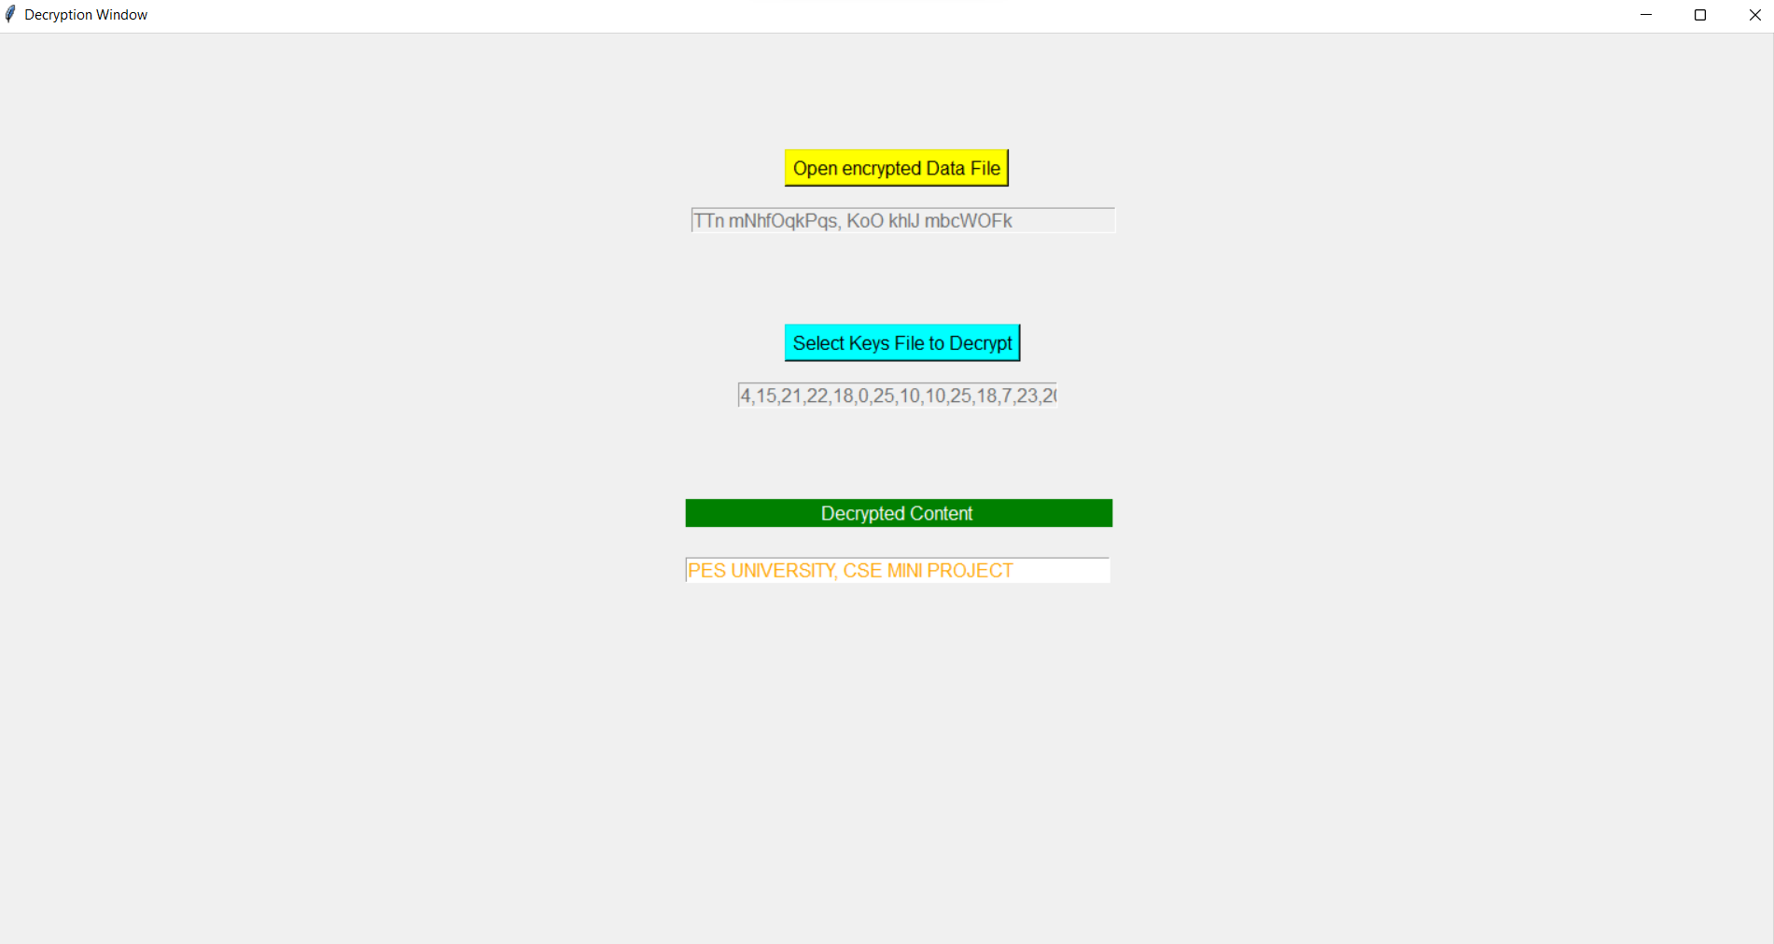
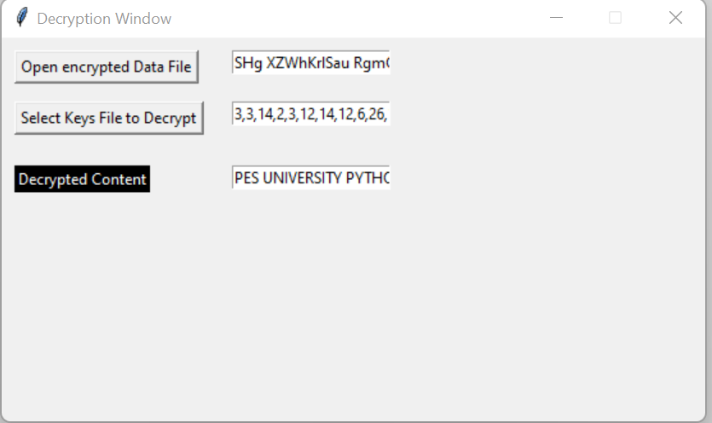
Demo.txt is selected
Generated key file is selected
Decrypted content is shown in a scrollable textbox.
‘PES UNIVERSITY CSE MINI PROJECT’ is shown

Slide 12
Limitations and Improvement
Key Generation: The generated keys have to be sent to the receiver from the sender only via trusted courier or by physical exchange(pen-drive,CD etc.) or by encrypted mails for security.
.File names :The file names are in plaintext { for easier access}, but file names also should be encrypted to enhance further security.
Instead of the random module of python if we were real secret agents, then using random might be a little insecure os.urandom is a much more secure way of generating random numbers.
The above features couldn’t be implemented either due to lack of time or due to the scope of the syllabus.
We wish to take these limitations into consideration and work on them to make sure the project works more efficiently in the future.

Slide 13
Conclusion
The project helped us achieve a good understanding how different GUI with binary files used as back end storage systems are used in various end to end encrypted application like WhatsApp, Facebook etc.
The impeccable need for a user-friendly interface in the current digital age.
We would like to thank PESU for the opportunity given that let us expand our knowledge on the same.
Hastalavista!

Slide 14
References
https://science.jrank.org/computer-science/Encryption-2.html
https://en.wikibooks.org/wiki/Cryptography/One_time_pads
https://projects.raspberrypi.org
www.geeksforgeeks.org
Modern Tkinter for Busy Python Developers: By Mark Roseman
https://docs.python.org/3/library/tkinter.html

Slide 15
References
https://engineering.fb.com/2021/09/10/security/whatsapp-e2ee-backups/
https://www.youtube.com/watch?v=yG0fAUn2uB0
Images from Google Images.

